Slide 1

Web Development
GROUP 12
Sukumar Bodapati
Sri Nikhitha Boddapati

Slide 2

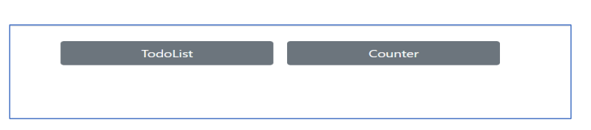
Angular
ICP
TodoList
Counter
Angular is a framework and platform that is written in TypeScript.
It is used for developing single page applications employing TypeScript and HTML template language.
Data binding and dependency injection.
Component-based architecture

Slide 3
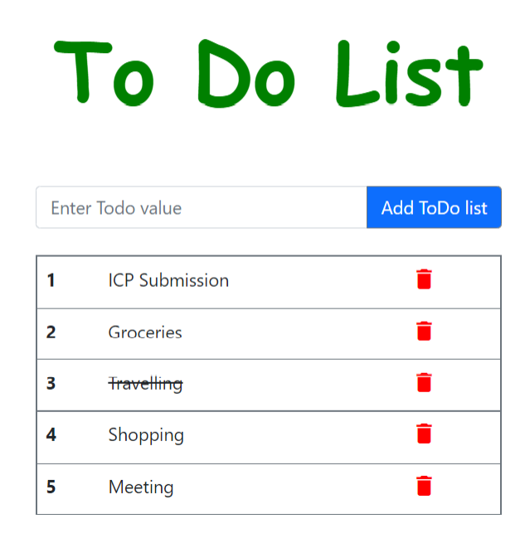
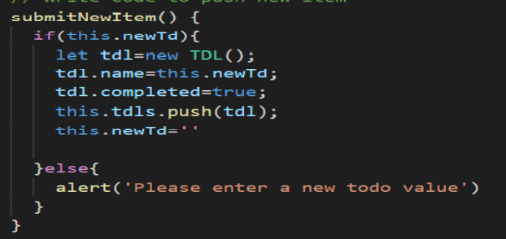



Slide 4

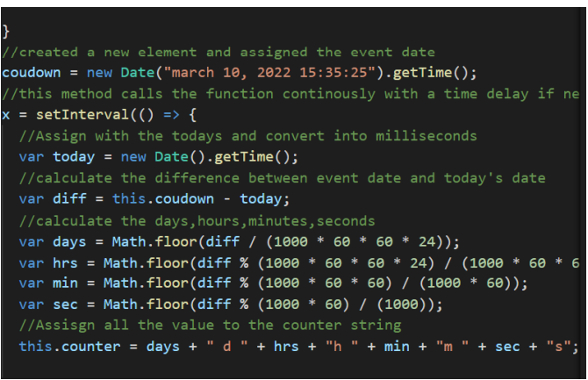

Slide 5
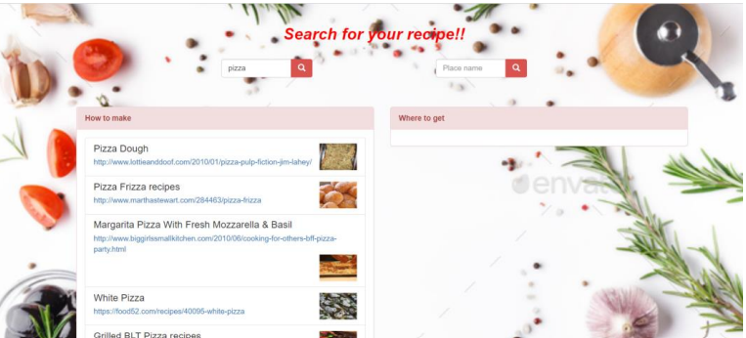
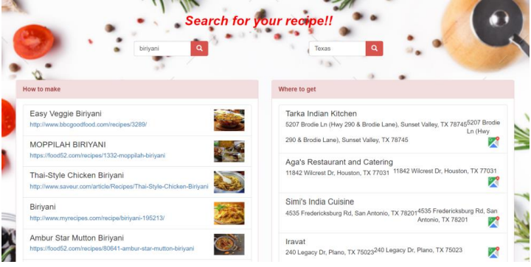
Rest API with Angular
Edamam API: To display recipes
Foursquare API: To display nearby place where this recipe is available.

Slide 6

Mobile Development
GROUP 12
Sukumar Bodapati
Sri Nikhitha Boddapati

Slide 7

Introduction to Andriod Studio
Why Andriod Studio:
Gradle Build System :Android Studio (AS) uses a highly integrated Gradle build system. It’s a great tool that offers dependency management.
Create and Manage virtual devices :Emulator
Availability Of Drag-And-Drop :
User Interface (UI)
Java Code Auto-Completion
Stability Of System
Contents in Mobile development
Basic Login Page
Pizza App
Interaction with API’s
TextToSpeech

Slide 8
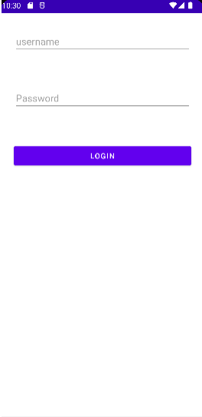
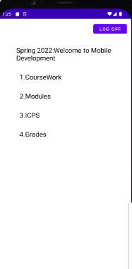
Login Page
Login page
Welcome page
Relative layout: this makes the element view relative to each other.
EditText: A user interface element for entering and modifying text.
Attribute for hiding the password Android:inputType="textPassword"
Switching Between activities : Intent

Slide 9
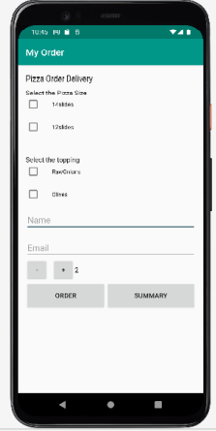
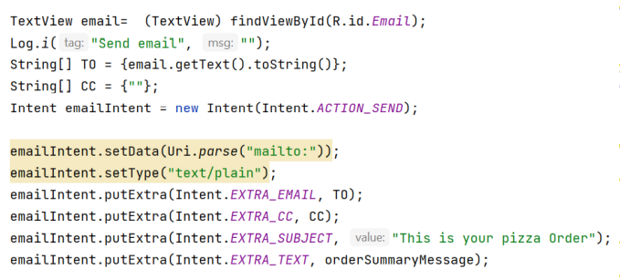
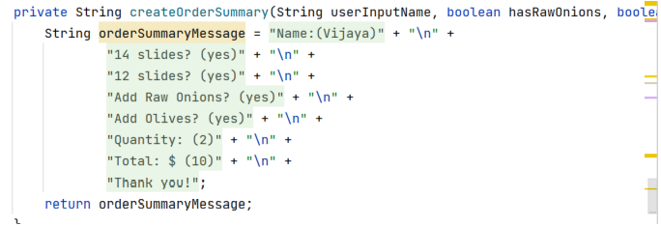
Pizza APP
Email Method
Summary

Slide 10
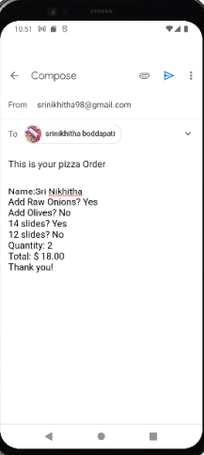
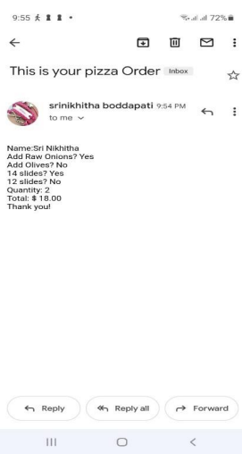
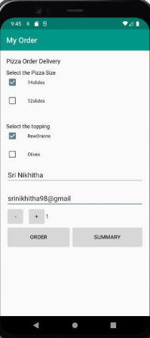
Click on “Order”
User Input
Mail compose
Mail received by the user

Slide 11
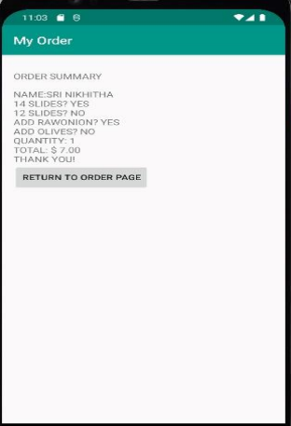
Click on “Summary”
Summary page
User Input

Slide 12
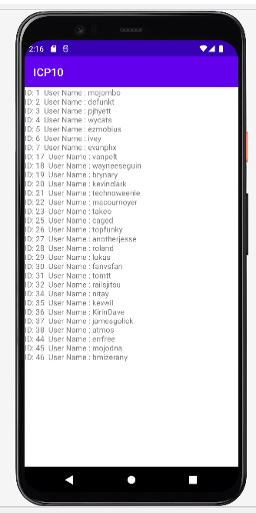
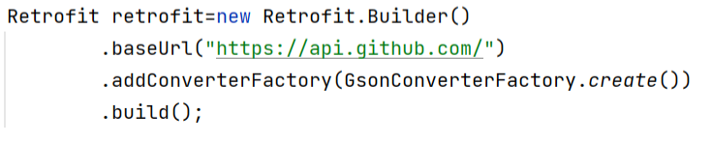
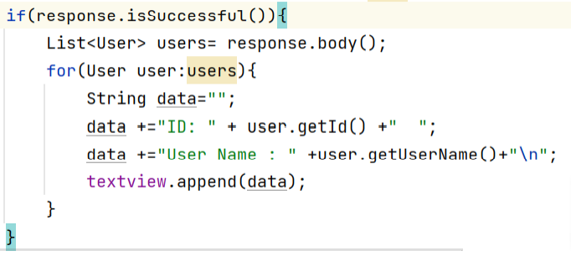
API calls with Andriod Studio
Retrofit: It manages the activities like sending, receiving, and creating the http requests &Responses.

Slide 13
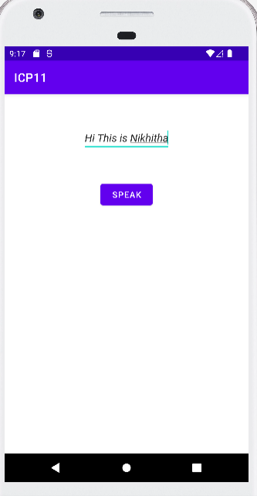
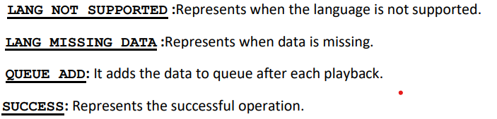
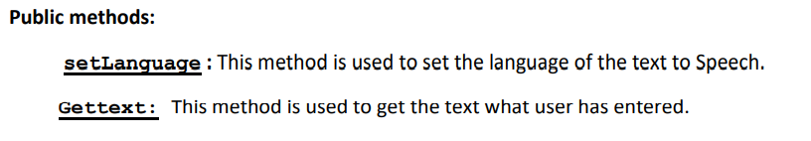
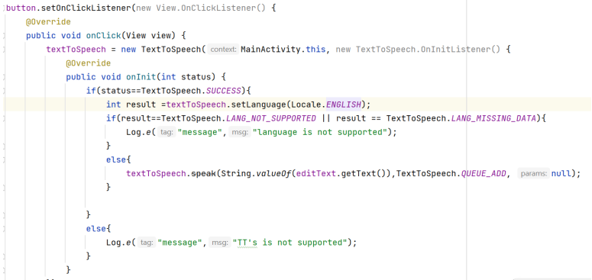
Text To Speech
We have a in-build class called Text to speech
Constants:

